Slide 1
Student Performance Analysis
By :
Fares Mohamed
Kerolos Samir
Mina Saher
Mahmoud Lela
Mohamed Walid

Slide 2
agenda
Objectives
Cleaning process
Analysis points
Dashboard

Slide 3
Objectives
The primary objective of this project is to explore various factors that influence student performance, particularly focusing on exam scores. By analyzing relationships between study habits, attendance, gender, parental involvement, and other environmental influences, we aim to provide insights that could help improve educational outcomes.

Slide 4

Cleaning process

Slide 5
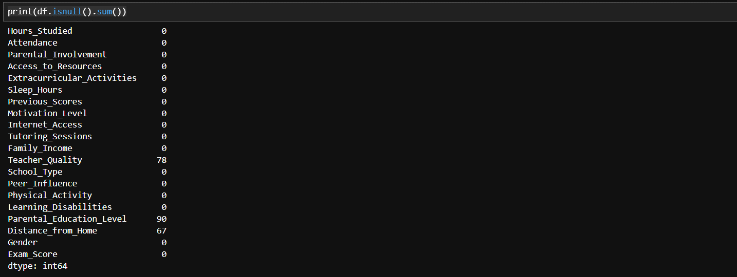
Checking for null values in the data

Slide 6
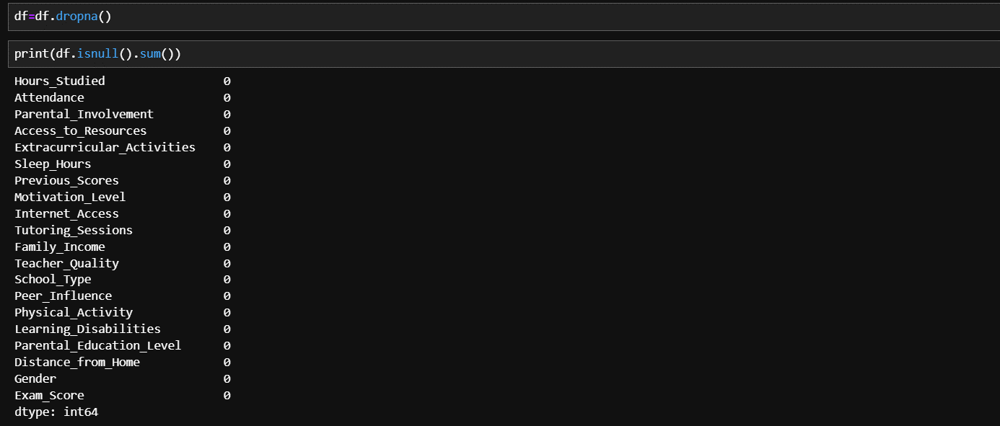
Cleaning null values in the data

Slide 7
Analysis points
The things we aim to get out of our data

Slide 8
Analysis points
Figuring out the relationship between the number of hours studied and the corresponding exam scores over different time periods.
Analyzing the impact of attendance on students' exam scores.
Comparing exam scores between male and female students to identify any significant differences.
Exploring how parental involvement and environmental factors affect exam scores.
Analyzing the relationship between school type, gender, and educational outcomes.
Analyzing the cumulative effect of study hours on overall exam scores.

Slide 9
dashboard
Visualizing the Data

Slide 10
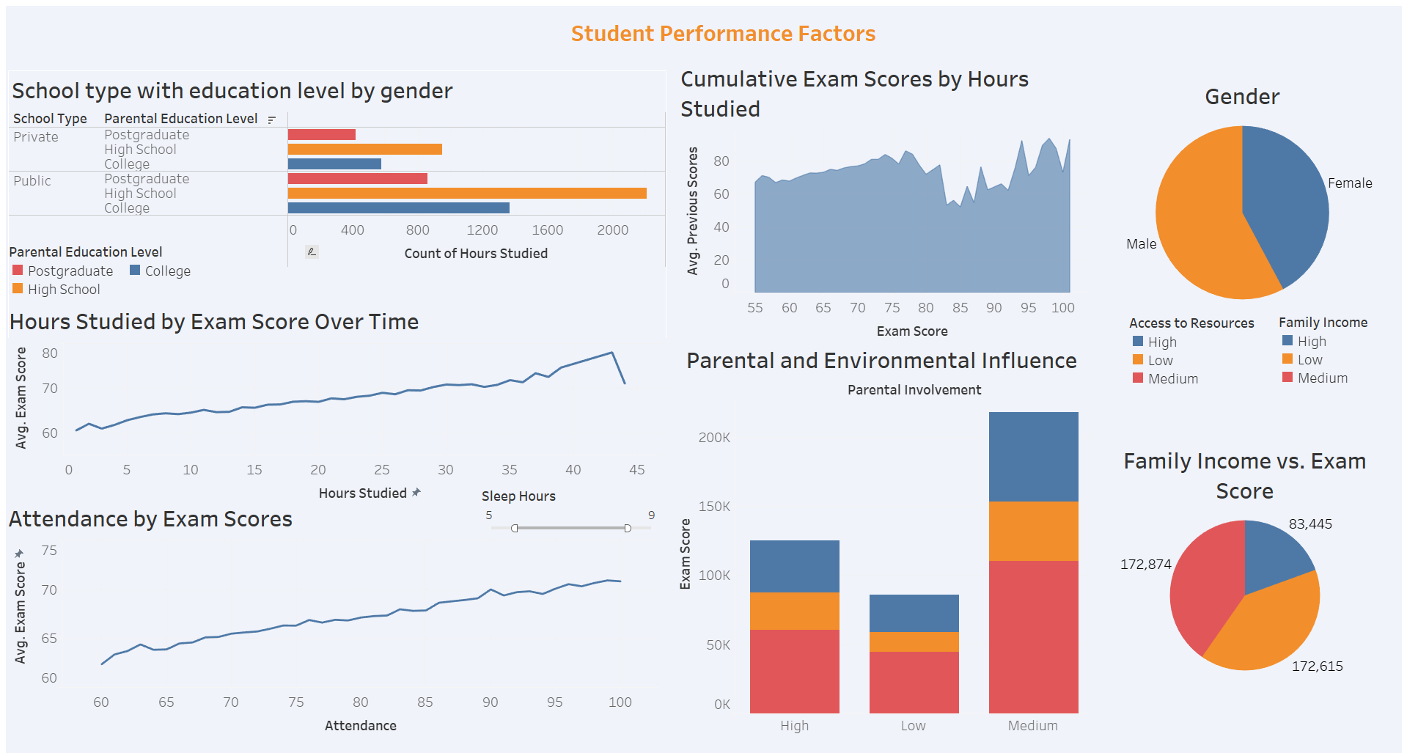

Slide 11
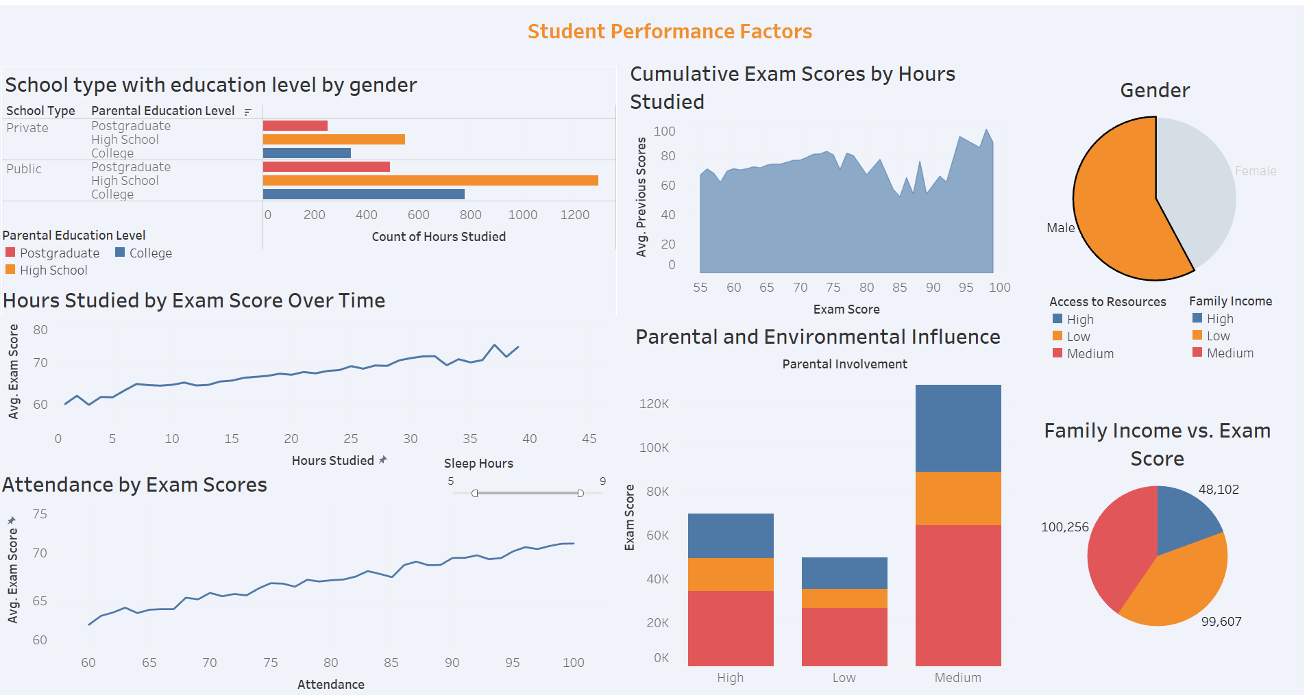

Slide 12
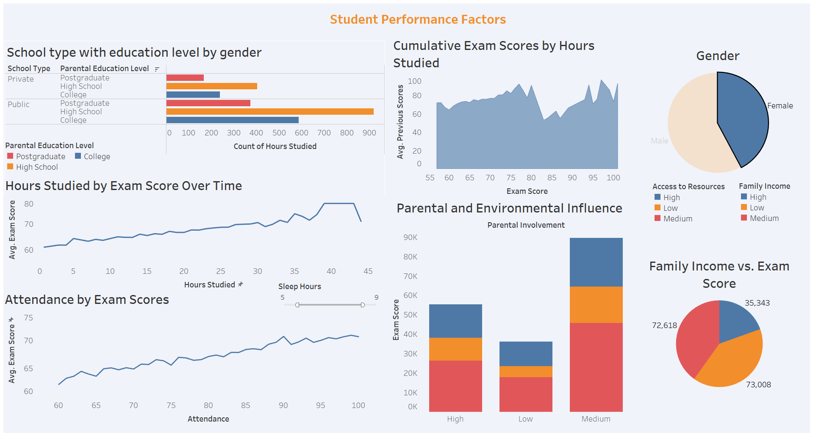

Slide 13
Thank you

